Slide 1
Hospitals in Mumbai vs Ratnagiri

Slide 2
Mumbai
Mumbai (formerly called Bombay) is a densely populated city on India’s west coast. A financial center, it's India's largest city. On the Mumbai Harbour waterfront stands the iconic Gateway of India stone arch, built by the British Raj in 1924. Offshore, nearby Elephanta Island holds ancient cave temples dedicated to the Hindu god Shiva. The city's also famous as the heart of the Bollywood film industry.

Slide 3
Ratnagiri
Ratnagiri is a port town in Maharashtra, western India. Overlooking the Arabian Sea, Ratnadurg Fort has the Bhagwati temple and a lighthouse. Northeast, a fish museum and aquarium includes turtles and a whale skeleton. Thibaw Palace was the residence of the exiled king of Burma. North of the city, Ganpatipule Temple is dedicated to Lord Ganesh. Northeast, Koyna Wildlife Sanctuary is a forested area sheltering tigers.

Slide 4
Population
Mumbai ~ 1.84 Crores / 18.4 Millions
Ratnagiri ~ 76, 000

Slide 5
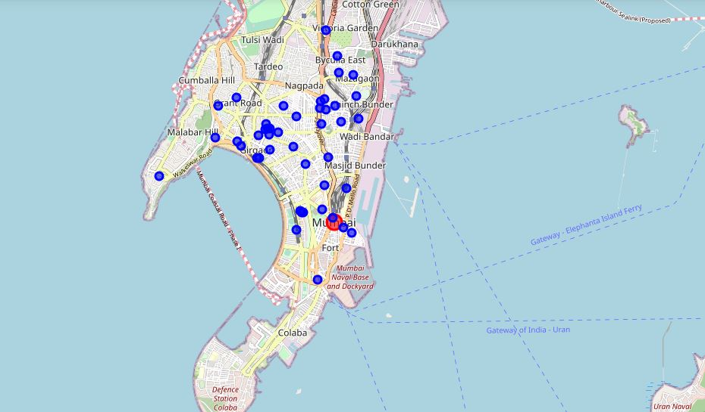
Hospitals in Mumbai

Slide 6
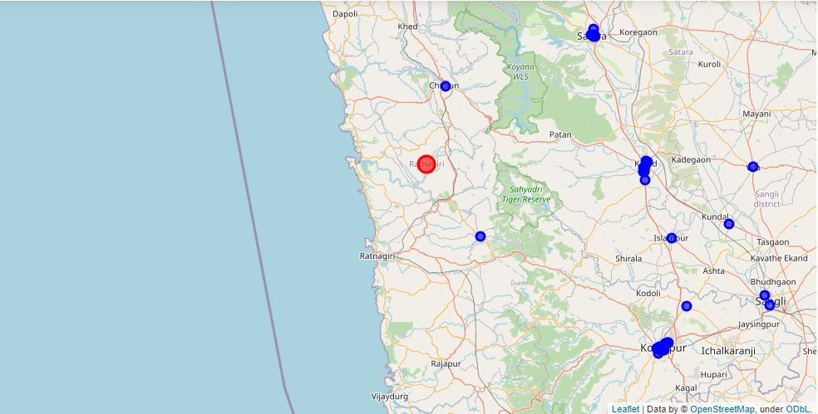
Hospitals in Ratnagiri

Slide 7
My thought…
Result of this study is that me fetched 50 records for each location The hospitals in Mumbai were denser than the hospitals in Rantnagiri hence more closer to the location. Though the hospitals in Mumbai were closer and denser than that of Ratanagiri, being a urban city, Mumbai has the population of 1.84 Crores (~18.4 Million). Can the hospitals of Mumbai handle this much of population? Are there enough beds for the patients? Whereas the population of Ratnagiri is of ~76,000, but the hospitals are far from the location. Beign in Rural area, is there good roads for the transportation? Is the transportation regular? Can patients and doctors reach at the destination on time?

Slide 8
Conclusion
Conclusion of my report is that population need to be handled or new hospitals is to be build in cities like Mumbai where people from all over the India migrate for jobs. Where as in rurals places, construction of new hospitals is must and transportation should be imporved. Further research is needed on the Number of beds available, number of ventilators available, number of soctors and other health workers available. This study was just to see the density and availability of the hospitals in urban and rural places on Maharashtra, India.

